Slide 1

COMET Techniques
Aruna S
Department of
Computer Science and Engineering

Slide 2

COMET TECHNIQUES
Server Sent Events
S. Aruna
Department of Computer Science and Engineering

Slide 3
COMET TECHNIQUES
Server Sent Events
Allows the server to asynchronously push the data to the client once the client-server connection is established.
Technology was proposed by the WHATWG
one-way publish-subscribe model
Send continuous updates to a client to increase cross-browser streaming through a javascript API called EventSource.
Constructor is EventSource()

Slide 4
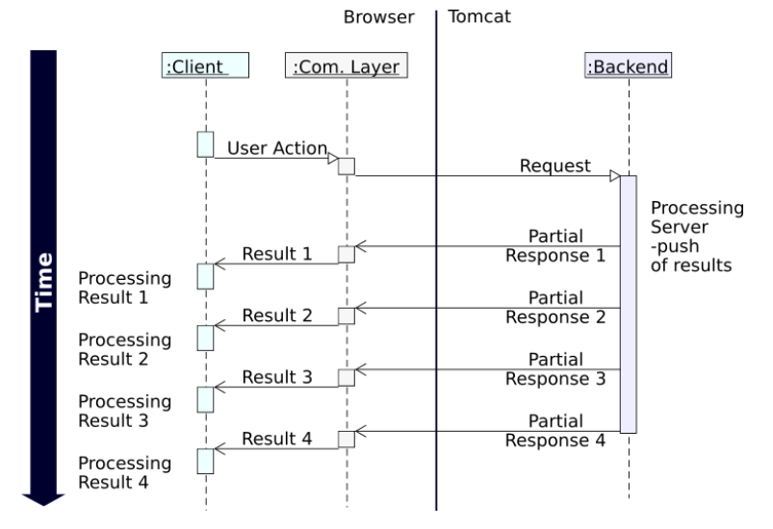
COMET TECHNIQUES
Server Sent Events

Slide 5
COMET TECHNIQUES
Server Sent Events – Real Time Applications
A few simple examples of applications that could make use of Server-Sent Events:
A real-time chart of streaming stock prices
Real-time news coverage of an important event (posting links, tweets, and images)
A live Github / Twitter dashboard wall fed by Twitter’s streaming API
A monitor for server statistics like uptime, health, and running processes.

Slide 6
COMET TECHNIQUES
Server Sent Events – Benefits
The main benefits we get from this approach are:
Simpler implementation and Data efficiency
It is automatically multiplexed over HTTP/2 out of the box
Limits the number of connections for data on the client to one
Automatic Reconnection

Slide 7
THANK YOU
Aruna S
Department of
Computer Science and Engineering
arunas@pes.edu

